Slide 1



<number>
The best for our IT Rockstars,
is the best for everyone

Slide 2



W
<number>
Project Loom
‘To infinity and Beyond’
Wat is Project Loom
Waarom
Hoe
Toekomst

Slide 3
Wat
<number>
Virtual threads
Delimited Continuations
Tail-Call optimizations

Slide 4
Wat
<number>
Virtual threads
Delimited Continuations
Tail-Call optimizations

Slide 5
Waarom
<number>
Betere throughput door virtual threads
Beter debuggen/profilen
OS threads schaalt niet

Slide 6
Hoe (theorie)
<number>
Performance meten
Throughput
Latency

Slide 7
Hoe (theorie)
<number>
Little’s Law → L = λW
L → Level of concurrency
λ → Rate of request
W →Gemiddelde wachttijd

Slide 8
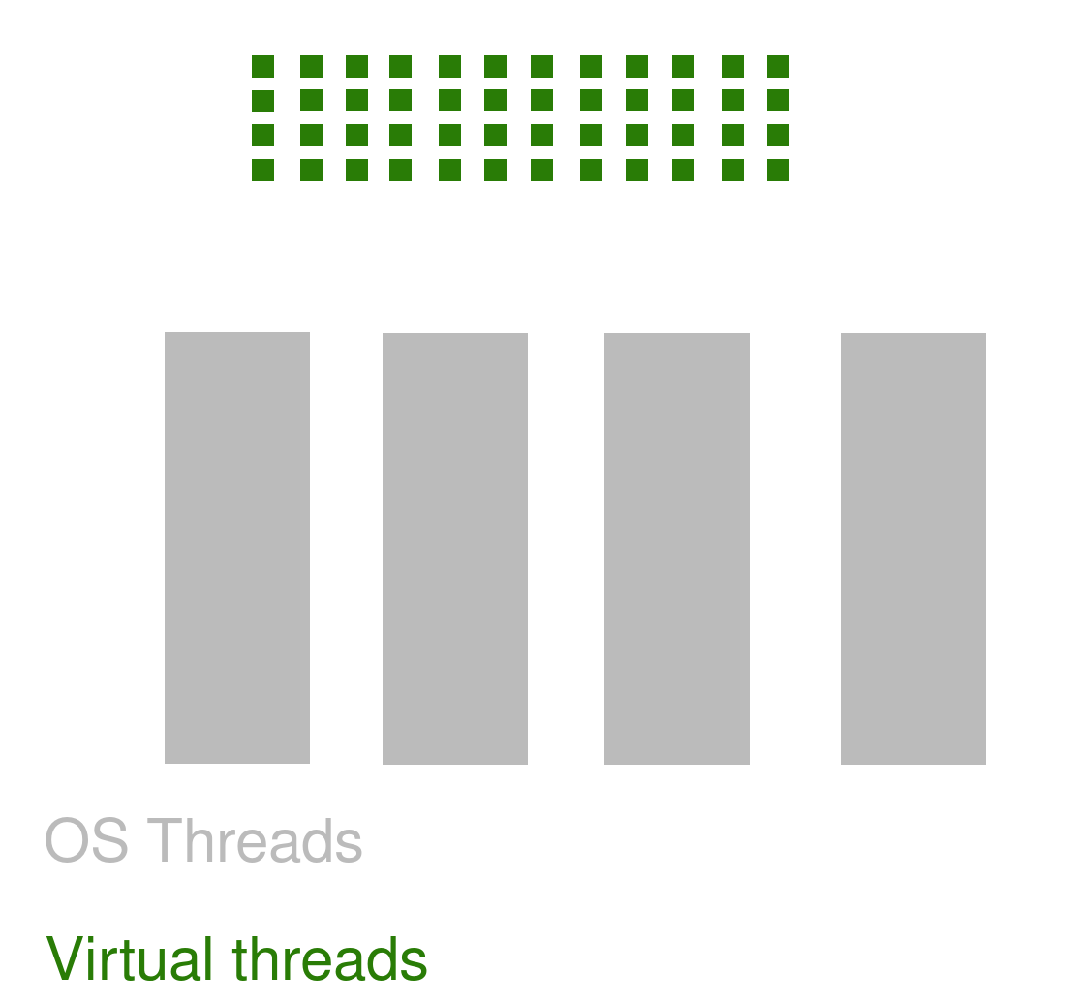
Hoe (implementatie)
<number>
Fork/Join pool
Eigen thread scheduler

Slide 9
Hoe (demo)
<number>
Demo tijd

Slide 10
Toekomst
<number>
Cloud native development met Loom
Async/Reactive ?

Slide 11

<number>
THANK YOU!!!
References and sources
Source code demo: github.com/waikontse/loom-presentation
Links to papers
State of Loom pt 1: https://cr.openjdk.java.net/~rpressler/loom/loom/sol1_part1.html
State of Loom pt 2: https://cr.openjdk.java.net/~rpressler/loom/loom/sol1_part2.html

